Slide 1
Library research data management services: a perspective from the USA
Tobin Magle, PhD
University of Wisconsin-Madison
Slides: http://bit.ly/2CJhnz2
Notes:
Abstract: Researchers today are facing unprecedented challenges in research data management. Data is larger and more complex than ever before, resulting in new challenges in storing and analyzing data. In the United States specifically, funding agencies are requiring researchers to include data management plans with their grant proposals and share their data with the research community along with their publications. These activities require skillsets that researchers do not typically learn in a formal way throughout their education, leaving an opportunity for libraries to help researchers meet these new demands. This presentation will outline the challenges faced by researchers and how libraries in the United States are participating in filling these gaps.

Slide 2
Outline
What is Research Data Management (RDM)?
Why is RDM important?
Why do researchers need help with RDM?
Where does the library fit in?
What professional development opportunities are there for librarians?

Slide 3
Research data management is...
… the policies, practices and procedures needed to manage the storage, access and preservation of data produced from a research project
Notes:
Just so that we are all on the same page, I define RDM as the policies, practices and procedures needed to manage the storage, access and preservation of data produced from a research project.
In short, it’s the things people DO during the research project to document the data well and make sure it isn’t lost.

Slide 4
Why is RDM important?
Notes:
But why is RDM important?

Slide 5
More digital data
Data are more fragile
Facilitates sharing
Need new skills
*ok not everything, but most things
Notes:
The last several decades have seen a rapid transition into digital data,
making data more fragile. For example, a hard drive crash is more likely than a natural disaster destroying physical records
The digital nature of data combined with the internet makes sharing possible. 30 years ago, this was not even possible. The only way to share research results was through journals.
This situations create

Slide 6
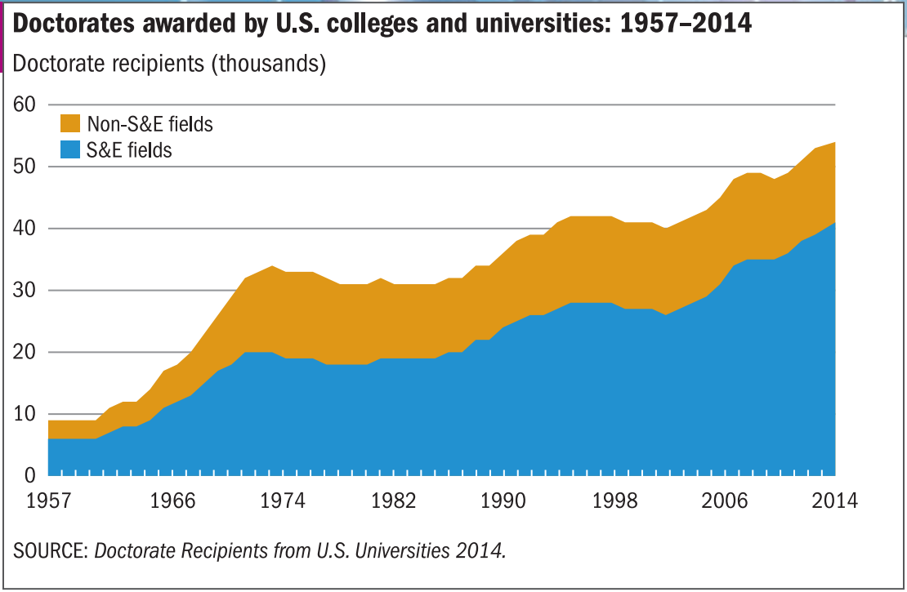
More researchers
https://www.nsf.gov/statistics/2016/nsf16300/digest/nsf16300.pdf
Notes:
In the US, the number of PhDs is growing. In fact it’s doubled since the mid 1970s
hence….

Slide 7
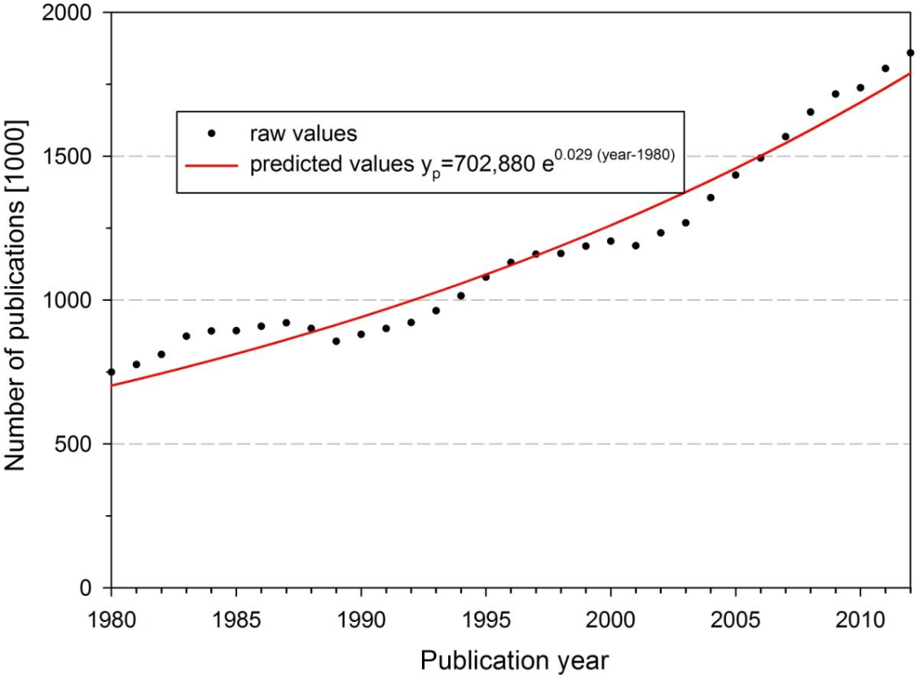
See arXiv:1402.4578 for details
Notes:
The scientific output is doubling every 9 years

Slide 8
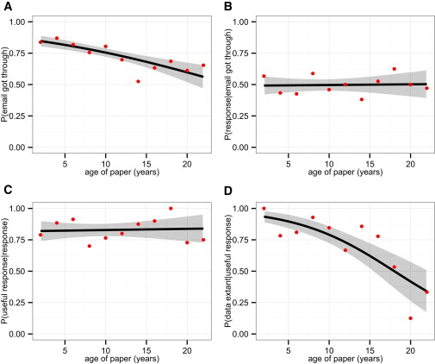
Response (if email working)
Working Email
Status of data
(if response)
Data are extant
(If status known)
doi:10.1016/j.cub.2013.11.014
Notes:
And after even 5 years after publication, the amount of research data that can be retrieved from researchers is less than half, and drops to about 5% by 20 years after publication.

Slide 9
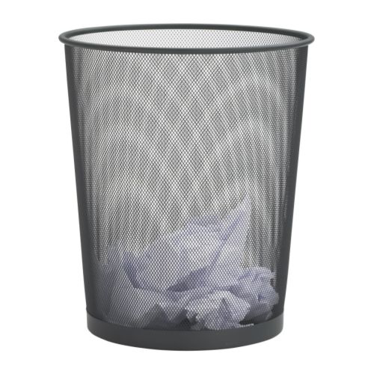
We are losing vast amounts of data
1
0
1
1
0
0
0
0
0
1
1
0
0
1
0
0
0
0
0
0
1
0
1
1
1
0
1
0
1
0
1
0
1
0
1
0
1
0
1
0
1
1
0
0
0
0
1

Slide 10
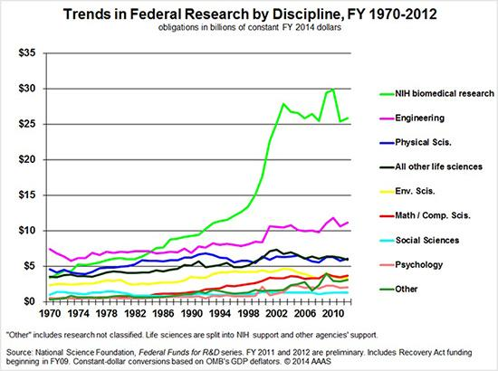
Research funding is not increasing in the US
http://www.bu.edu/research/articles/funding-for-scientific-research/
Notes:
Despite a steady increase in the number of PhDs, research funding is more or less flat

Slide 11
US Funders require
data sharing
Reproducibility
Data reuse
Openness
Notes:
Given limited resources, these funders require data sharing
First to ensure that the work is reproducible
Also to allow other researchers to use the data to glean new insights outside the scope of the other research
And to make these results available not just to other researchers, but to the public as well.
Here are some examples of wording from these funder policies

Slide 12
National Science Foundation
Investigators are expected to share with other researchers ... the primary data... Grantees are expected to encourage and facilitate such sharing.
- NSF Dissemination and Sharing of Research Results
Notes:
NSF not only wants researchers to share data, but also for them to encourage and facilitate this sharing

Slide 13
National Institutes of Health
As required by 45 CFR 75.322, recipients that are institutions of higher education, hospitals, or non-profit organizations must release research data first produced in a project supported in whole or in part with Federal funds that are cited publicly.
- NIH Access to Research Data
Notes:
The NIH indicates that researchers must release research data produced with federal funds

Slide 14
National Institutes of Health (Draft)
Submission of a Data Management and Sharing Plan (Plan) outlining how scientific data will be managed and shared, taking into account any potential restrictions or limitations … timely sharing of scientific data and accompanying metadata resulting from NIH-funded or conducted research.
DRAFT NIH Policy for Data Management and Sharing
Notes:
NIH has recently released a draft policy describing new more specific guidelines about data sharing, most notable requiring data management plans

Slide 15
Department of Energy
Sharing and preserving data are central to protecting the integrity of science by facilitating validation of results and to advancing science by broadening the value of research data to disciplines other than the originating one and to society at large. To the greatest extent, with the fewest constraints possible, and consistent with the requirements and other principles stated in this document, data sharing should make digital research data available to and useful for the scientific community, industry, and the public.
-DOE Policy for Digital Research Data Management
Notes:
The department of energy goes so far as to say that sharing and preserving data are central to protect the validity of research, and advocates sharing to the greatest extent and the fewest constraints and emphasizes that the data should be available and useful.

Slide 16
Publishers require
data access
For review process
For all readers
Restrictions

Slide 17
Nature
Supporting data must be made available to editors and peer reviewers... All manuscripts reporting original research published in Nature journals must include a data availability statement
- Nature Availability of Data
Notes:
Nature journals mandate that the data be made available to reviewers and editors, and the authors must also provide a statement outlining how the data will be available to readers.

Slide 18
Science Journals
After publication, all data and materials necessary to understand, assess, and extend the conclusions of the manuscript must be available to any reader of a Science Journal... Unreasonable restrictions on data, code, or material availability may preclude publication.
- Science Journals Editorial Policy
Notes:
Science Journals go futher to require that all materials needed to produce the paper must be made avalaible to any reader, and that unreasonable restrictions could preclude publication.

Slide 19
Public Library of Science
PLOS journals require authors to make all data underlying the findings described in their manuscript fully available without restriction at the time of publication.
- PLOS Data Availability Statement
Notes:
The public library of science goes even further,

Slide 20
Why do researchers need help with RDM?
Notes:
The definition seems pretty straightforward, but researchers still struggle to manage their research data

Slide 21
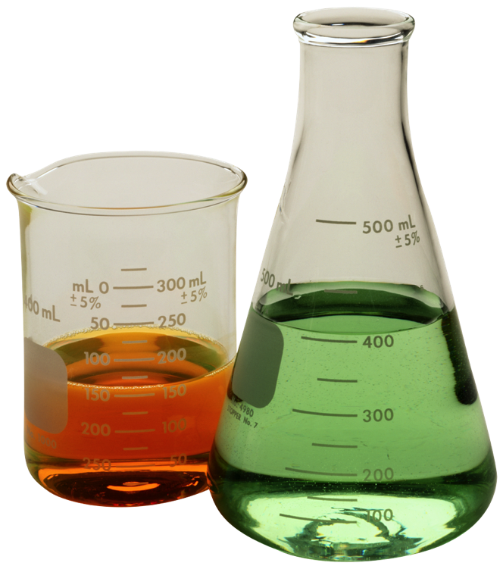
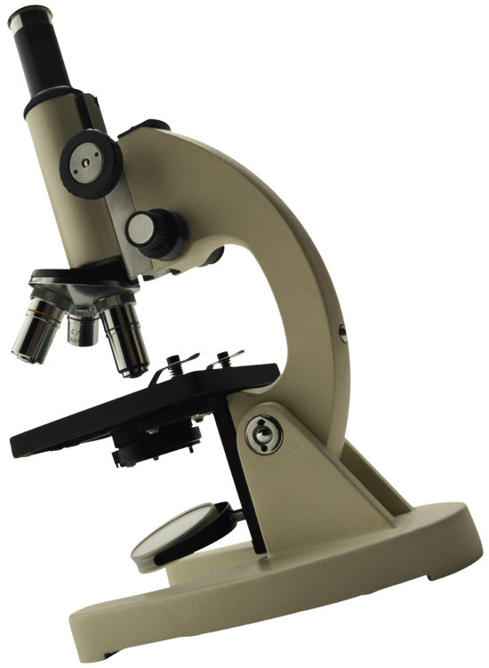
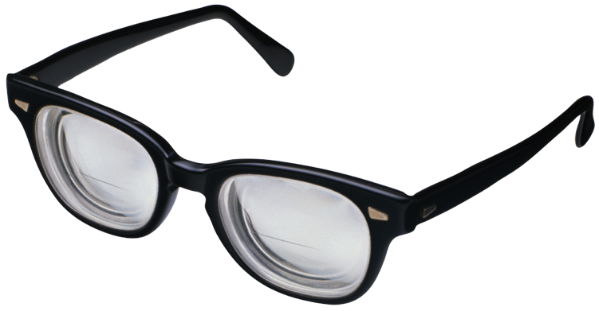
PhD training is free-form
2 years of classwork
~5 years of experiments
Congrats Dr.!
Write a dissertation
Notes:
All of the formal instruction PhD students get is in classes - which usually doesn’t contain RDM topics
All basic science classes- learn to pick apart papers
Training in the lab is often done on the fly: no formal training on “soft skills” like how to manage data, publish, look for pre-existing data (literature or datasets)
This degree is essentially training us to be a professor at a research institution, which is interesting because….

Slide 22
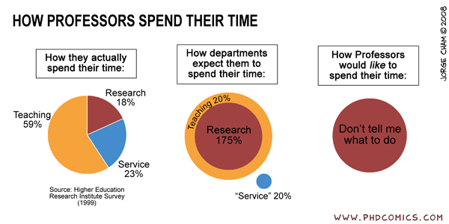
Notes:
Professors however, spend a lot of time on the things that will earn them tenure:
Research most importantly, but also teaching and service
They don’t have a lot of time to add anything new to their plate, including RDM
Also, professors like to be independent, and don’t like it when they have rules imposed on them

Slide 23
How do libraries fit in?
Notes:
Now that we know the scope of the issue, let’s talk about how libraries fit in. This fit might not be obvious because...

Slide 24
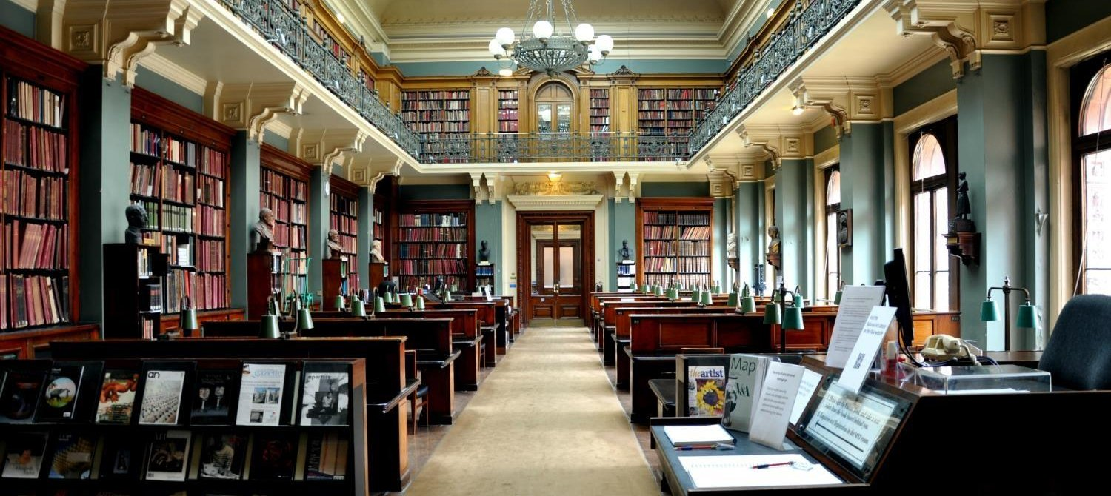
Libraries = books
Notes:
Many people, researchers especially, associate libraries with checking out books

Slide 25
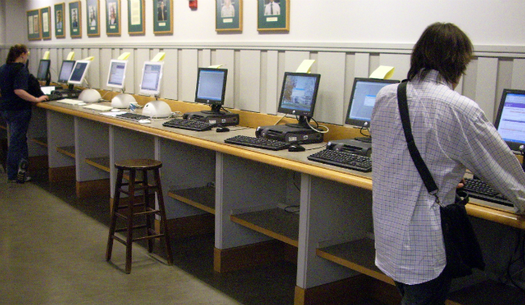
Libraries = digital information
Notes:
However, because libraries are more and more licensing electronic resources, they are really a place for digital information more than anything.

Slide 26
Libraries = data?
Notes:
So given that we’re already dealing in digital information, is it such a far step to think that Libraries could be involved in working with data?

Slide 27
Librarians have relevant RDM skills
Finding records in databases
Digital Object Identifiers
Working with metadata
Helping with compliance
Open access policies
Citation management
Repositories
Notes:
I believe that librarians already have skills that are relevant to research data management
Data is not much different from other electronic resources
We can find it in databases and by using digital object identifiers
We can describe it using metadata standards
And we can help researchers comply with policies imposed on them by funding agencies and publishers like we do with manuscripts through OA compliance and citation management.
Finally, many librarians already ingest material into their institutional repositories, and could do the same for research data to help researches comply with funder and publisher guidelines

Slide 28
Providing research data services in libraries
Notes:
So what do research data services look like in an academic library?

Slide 29
Common services
Data management planning
Data Organization
Metadata standards
Data Repositories
Notes:
Common services include data management planning, organization, finding metadata standards and depositing data into repositories. Let’s look at these individually for more detail.

Slide 30
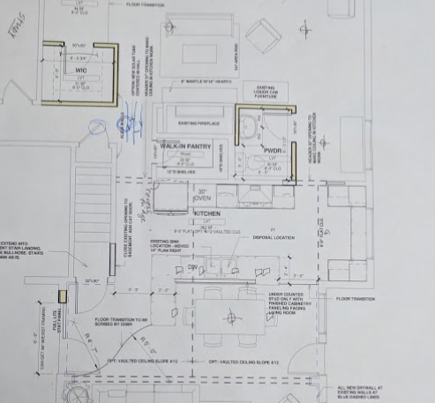
Planning
What data will you produce?
Where will you store it?
Size
Security
Backup
How will you document it?
Use standards
thinking through and documenting how data and other materials will be organized, saved, prepared, analyzed, and shared over the course of your research project
Notes:
Helping researchers make a plan before they even start collecting data can make data management a lot easier. I mentioned earlier that in the US, many funding agencies require data management plans, but the process can still be helpful in the absence of requirements.
Things to think about can include
What data will be produced
Where it will be stored, which can depend on how big it is, how sensitive the data are, and how the data will be backed up
It also includes a plan for documenting the data

Slide 31
Helping with Data Management Planning
Novice: Help researchers find data management best practices
Intermediate: Be familiar with data planning best practices
Advanced: Review data management plans and provide feedback
Notes:
This type of support can take many forms.
Novices in this area can help researchers find best practice information from other institutions for issues addressed during their planning
More experienced librarians can familiarize themselves with with these best practices and be able to deliver education sessions about data management best practices
Those who are able to focus a large part of their effort to RDM could also read data management plans and provide feedback.

Slide 32
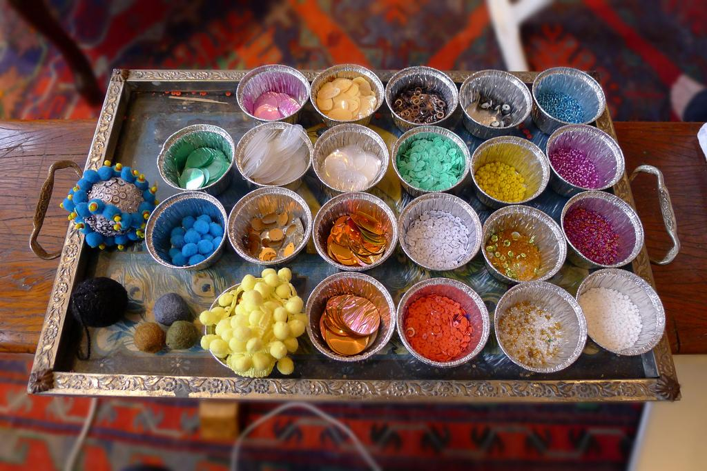
Data Organization
Organizing files into folders
Using descriptive file names
Devising templates that can be used for multiple projects
Crafternoon by Stephen Kennedy
arranging your data and other research materials so they can be found – by yourself and by others – as needed
Notes:
Another service that is often offered in academic libraries is advice on data organization.
This covers topics like hierarchical organization strategies
Using descriptive file names
And creating strategies that can be used in multiple projects.

Slide 33
Helping with Data Organization
Novice: Point researchers to best practices content
Intermediate: Help researchers apply best practices to their research
Advanced: In depth consultations on research data organization and ability to recommend specific tools or strategies based user data
Notes:
Much like planning, novices can point researchers to best practices, intermediate data practitioners can teach researchers about best practices, and advanced users can help researchers apply these

Slide 34
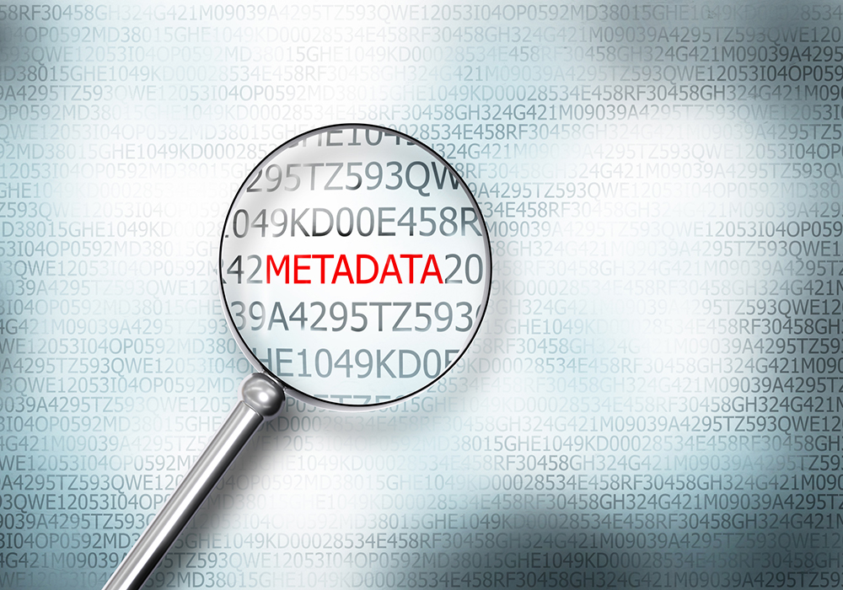
Metadata
Including README files to describe the data
Using commonly used metadata standards
Creating a standard where none is available
describing your data and other research materials so they can be understood – by yourself and by others – as needed
Notes:
Librarians can also help with metadata for research data. For example, researchers need help with
Writing good readme files that describe their data
Finding and implementing metadata standards for their field or datatype
And implementing standards where none were available

Slide 35
Helping with Metadata
Novice: Point researchers to information online about metadata standards
Intermediate: Help researchers find appropriate metadata standards
Advanced: Help researchers devise a metadata standard where none are available

Slide 36
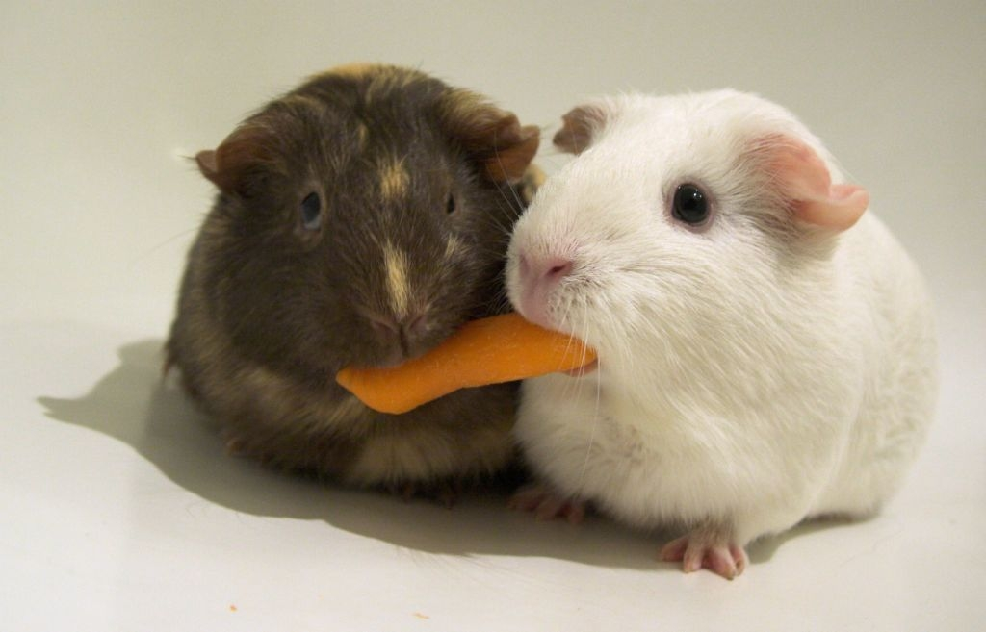
Sharing Data
Findable: How will users know it exists?
Put in a repository w/ DOI
Accessible: How will users get the data?
Repositories + Data access statement
Interoperable: Can it be combined with similar datasets for meta-analyses?
Use common (meta)data standards
Reusable: Can users use it for new purposes?
Use open file formats and permissive licenses (CC-0)
Sharing by ryancr
making your data available so that they can be accessed and used - by yourself or by others - in the future
Notes:
Researchers also need help with data sharing to meet requirements that we described previously. The shared data needs to be…
Findable - meaning, how will other users know it exists?
Accessible - referring to the method of access to the data
Interoperable - meaning that it can be combined with similar data and
Reusable - in that it has a permissive license and file formats that can be read by others

Slide 37
Helping with Data Sharing
Novice: Help researchers find data repositories to share their data
Intermediate: Help researchers prepare their data to meet researcher requirement
Advanced: Facilitate research data submission into your institutional repository
Notes:
There are a lot of ways for librarians to help with Data Sharing:
Novices can help researchers find data repositories to share their data
Intermediate data practitioners can help researchers prepare their data for submission
And advanced programs often facilitate data deposits into their own institutional repositories

Slide 38
What do RDM services look like in practice?
Notes:
Now that you have an idea of the topics that are commonly covered, I’d like to tell you more about the positions that I’ve had involving data services

Slide 39
3 libraries, 3 different positions
Education and Reference
Digital Collection Services
Science and Engineering Libraries (Public Services)
Notes:
First, I’d like to note that there’s no one right way to provide services.
I have about 5 years of experience working in libraries providing research services.
I’ve worked in the education arm of a health science library
I have worked in Digital Collections and a state university
And I have worked in the science and engineering libraries at a large research university
Every institution has been unique, but there have also been a lot of common things that come up.

Slide 40
3 libraries, 3 different target audiences
Basic Science
Everyone
STEM researchers
Notes:
I also had different target audiences at the places that i’ve worked
At the health sciences library, I catered to basic sciences researchers
At the state university, I provided data services for the whole campus
Whereas at the larger university, I focused my efforts on the Science, Engineering and Math departments on campus
And the services that I offered at each place depended on the audiences i was serving and what was already available on campus.

Slide 41
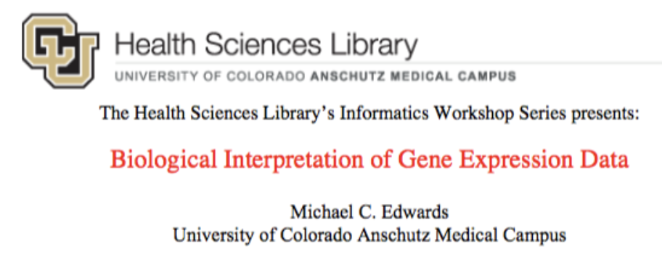
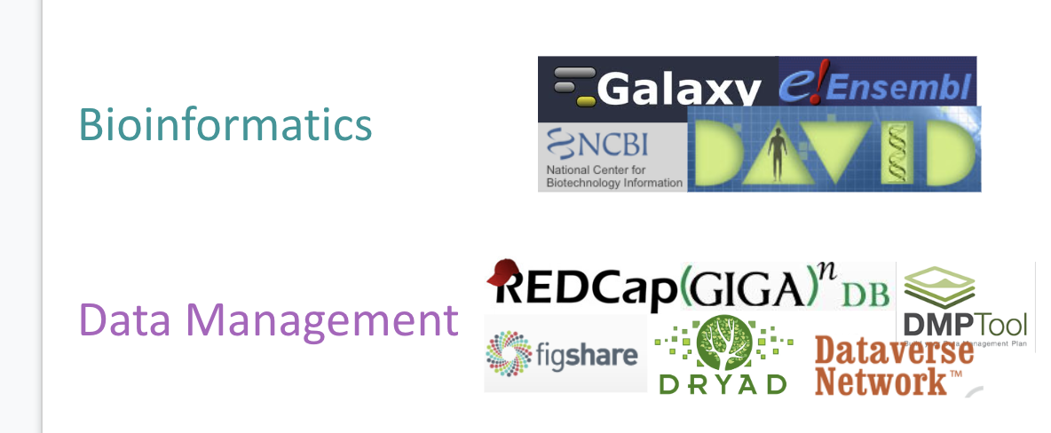
Services @ Health Sciences
Informatics workshop series
Library workshops
Consultation services
Notes:
The health sciences library was my first library job. While I had worked in research for about a decade before, I didn’t receive a lot of research data management training.
So while I was improving my skills, I decided to leverage the expertise by hosting an informatics workshop series.
After I gained skills in searching gene databases and programming in the R programming language, I started offering library classes and consultation services on the topics that i trained on.

Slide 42
Services @ Colorado State
Workshops:
Data management
R programming
Consultations
Research data self-submission
Notes:
In my second library position, I had more experience in topics that were relevant to researchers,
so i taught 2 workshop series: one on RDM and one on programming.
I also took consultations on any topic covered in the workshops
But much of my time was spent ingesting reserach data records into our institutional repository. I developed a data self submission form, and suggested improvements to the submissions before ingesting them into the repository

Slide 43
Joined Teams at UW-Madison
Consulted on RDM topics
Teach coding workshops, develop new lessons
Support use of Electronic Lab notebook team
Notes:
However, when I moved to a larger research university, they already had many research data services. So instead of starting my own services, I joined teams and added value:
Research data services provided workshops and consultations on research data topics. I joined their team to increase capacity for RDM services.
I also joined the local chapter of the carpentries organization. The Carpentries is a non-profit organization that trains researchers to use computational tools more effectively. I taught and helped in these 2 day workshops, and also recruited other instructors to help in my coding workshop series through the library.
Finally, I joined the electronic notebook team. UW-Madison was the first institution I had been at to have a site license for an electronic lab notebook system. Through this team, I onboard labs to the system and help with user support in conjunction with IT and other library staff.

Slide 44
Advice
Get to know your campus
Who is your target audience?
What resources are already available on campus?
Develop partnerships
Fill in gaps in service
What value can you add to your institution?
Know your limits!
Keep an open mind
Unexpected opportunities can be fruitful
Notes:
If I had to give advice to someone just starting out, here’s what I”d say.

Slide 45
Professional development
Conferences; Communities of practice; training programs
Notes:
We just went over a lot of information, and it can seem daunting, but now let’s talk about ways that librarians can skill up in these areas.

Slide 46
Research Data Access & Preservation Association
https://rdapassociation.org/
Notes:
In addition to my role at the libraries, I am also the President of the Research data access and preservation association for this fiscal year.

Slide 47
RDAP Mission
RDAP supports an engaged community of data practitioners committed to creating, maintaining, advancing, and teaching best practices for research data, access, and preservation.
Notes:
RDAP is a really great community of librarians, data managers, and more that work with research data every day.

Slide 48
RDAP Community
The RDAP community brings together a variety of individuals, including data managers and curators, librarians, archivists, researchers, educators, students, technologists, and data scientists from academic institutions, data centers, funding agencies, and industry who represent a wide range of STEM disciplines, social sciences, and humanities.
Notes:
Our community encompasses all types of data practitioners that serve all research disciplines

Slide 49
2020 RDAP Summit
Connecting Through Data
March 11-13, 2020
Santa Fe, New Mexico, USA
https://rdapassociation.org/summit-info/
Notes:
We do have an annual summit that is based in the US. This year’s theme is “Connecting through Data.” For more information, go to our web site

Slide 50
Keep in touch with RDAP
RDAP listserve: http://mail.kunverj.com/mailman/listinfo/rdap
Become a member (FREE until July 2020): https://rdapassociation.org/membership/

Slide 51
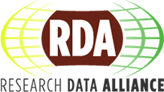
Research Data Alliance
https://www.rd-alliance.org/
Notes:
Another organization that is more international is the Research Data Alliance. RDA operates in working groups and is more concerned about creating infrastructure to promote data sharing and data driven research

Slide 52
RDA Plenary
Notes:
Another organization that is more international is the Research Data Alliance. Their annual meeting will be in Australia in March. RDA business operates in working groups and is more concerned about creating infrastructure to promote data sharing and data driven research

Slide 53
https://carpentries.org/
Notes:
If you’re interested in learning more about programming and computational skills, I would recommend looking into the Carpentries, which is the organization where i got my start teaching coding workshops. They are an international non-profit that aims to lower the barrier to entry to computational research. They have even recently added “Library Carpentry” as a way to help librarians learn data skills that will help them do their work.

Slide 54
https://2020.carpentrycon.org/

Slide 55
https://rdmla.github.io/
Notes:
Additionally, there is a new online course called Research Data Management Librarian Academy to jump start skills in data management. The RDMLA curriculum focuses on the essential knowledge and skills needed to collaborate effectively with researchers on data management. The curriculum features Eight Online Self-paced Learning Units that covers topics such as the foundations of research data management (RDM), research culture, advocating and marketing for RDM services in libraries, project management, overview of research data management tools and etc.

Slide 56
Other resources
Data Curation Profiles Toolkit: http://datacurationprofiles.org/
Best practices
University of Wisconsin-Madison: http://researchdata.wisc.edu/learn-about-data-management/
University of Minnesota: https://www.lib.umn.edu/datamanagement/best-practices-templates
Data One Education modules: https://www.dataone.org/education-modules
DataCure: https://docs.google.com/document/d/1ojXRTbVy51vkABZDst2r-rEm34VxcxIRSuisOU8pXGo/edit
Notes:
I don’t have enough time to go through all of the useful resources.

Slide 57
Thank you!
Acknowledgements
Elsevier
UW-Madison
Science and Engineering Libraries
Research Data Services
Office of Research Cyberinfrastructure
RDAP community
Colleagues
Trisha Adamus
Cameron Cook
Heather Shimon
Sarah Stevens
Questions?
Slides:
http://bit.ly/2CJhnz2

